Slide 1
OCaml: Tail Recursion
CMSC 330: Programming Languages

Slide 2
Recursion
A function is recursive if it calls itself
Two required components:
A base case: very simple so it can be trivially solved. Does NOT call itself
A recursive case: reduce the problem to a smaller version of the same problem towards the base case
We can have multiple base cases
We can have multiple recursive cases

Slide 3
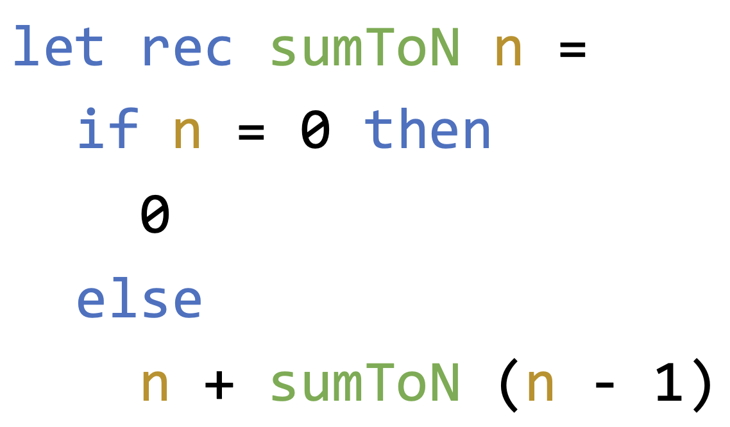
Tail Recursion
A function is tail recursive when its recursive call is the very last operation the function performs
This means that the result of the recursive call cannot be further used in any computation
Is this tail recursion:

Slide 4
A Recursive Problem: Summing 0 … N
What is the ‘state’ of this function?
If we need to rewrite it with a loop, what variables would we introduce?

Slide 5
A Recursive Problem: Summing 0 … N
The ‘state’ sum changes: 0 -> 1 -> 3 -> 6 -> 10 -> …
Can we keep track of the state in a recursive function and make it tail recursive?

Slide 6
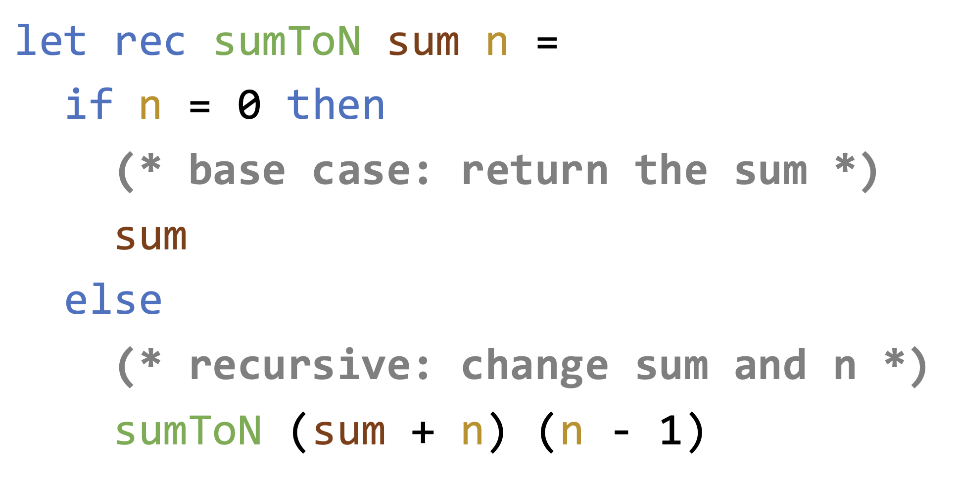
A Recursive Problem: Summing 0 … N
This is equivalent to a while loop with
sum = sum + n
n = n - 1

Slide 7
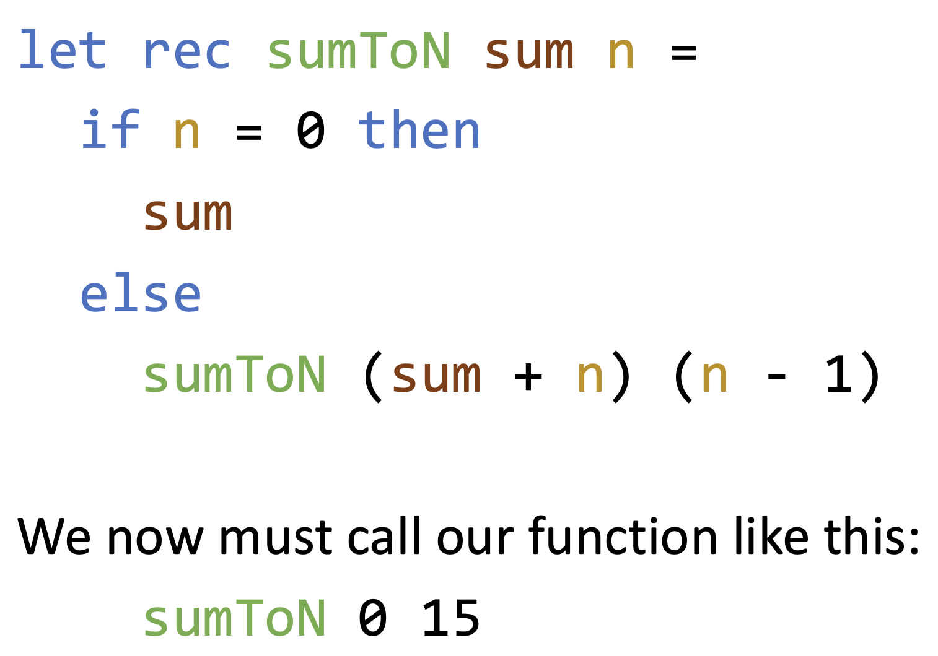
Problem: The Extra Parameter

Slide 8
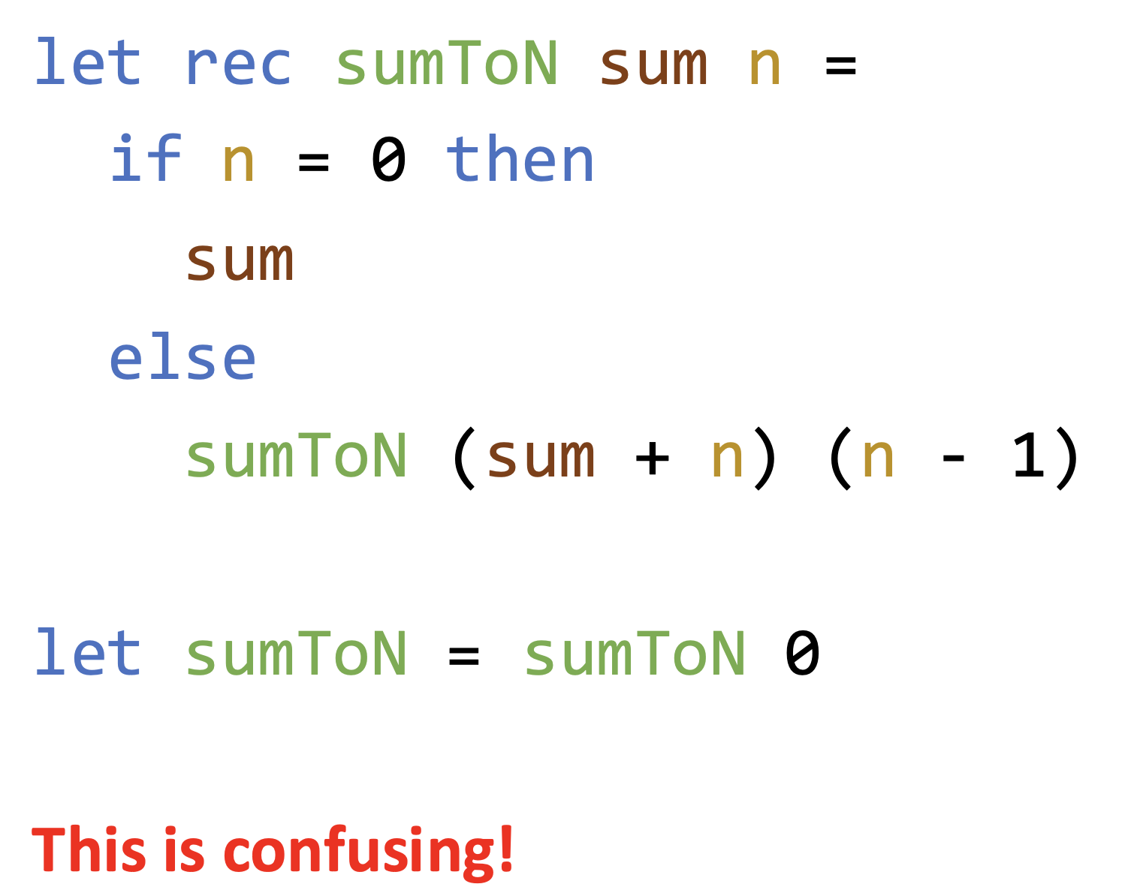
Solution 1: Rebind (DO NOT DO THIS!)

Slide 9
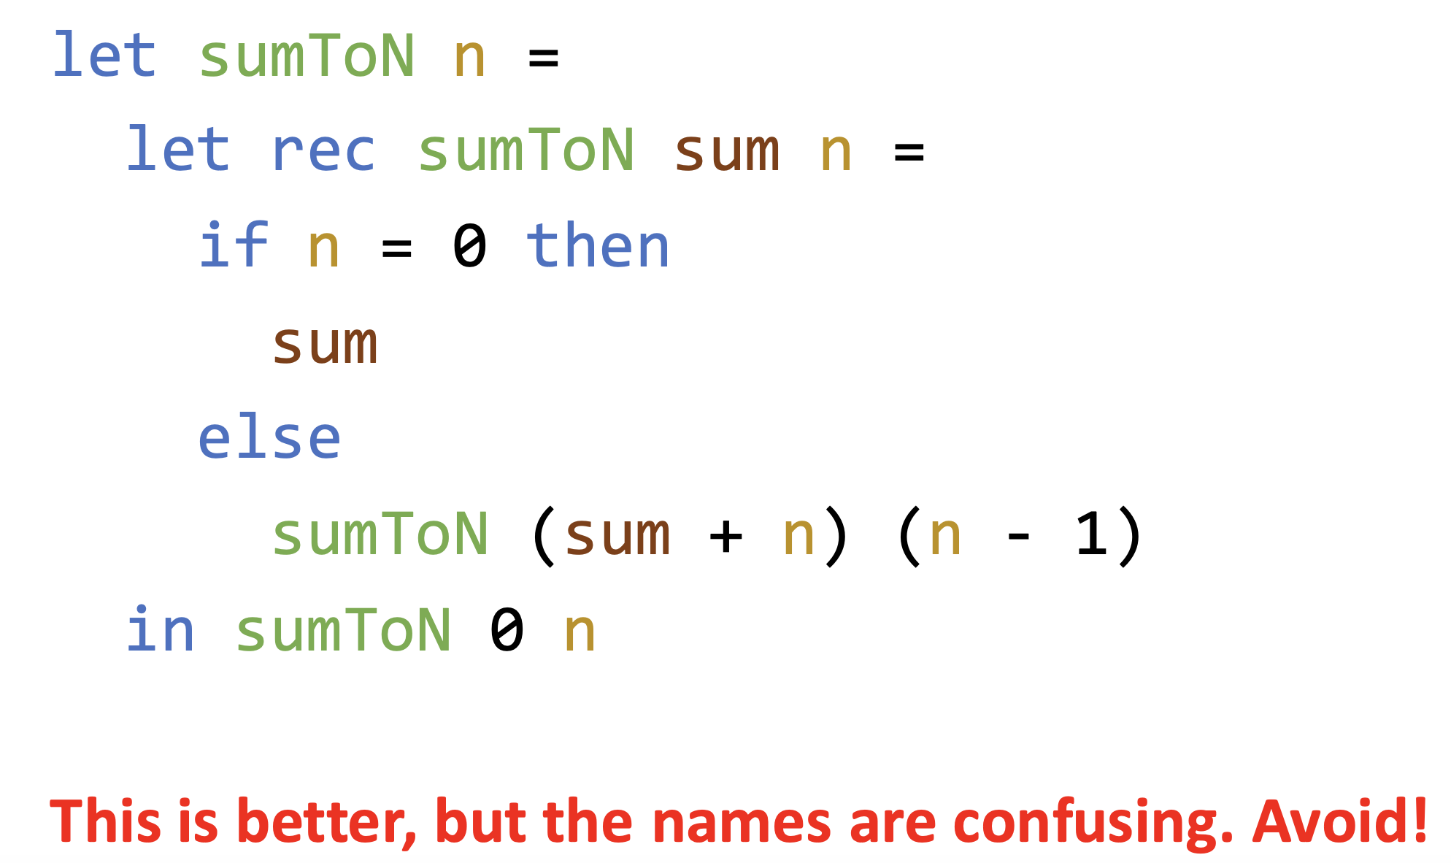
Solution 2: Create a Local Binding
How to create a local environment?

Slide 10
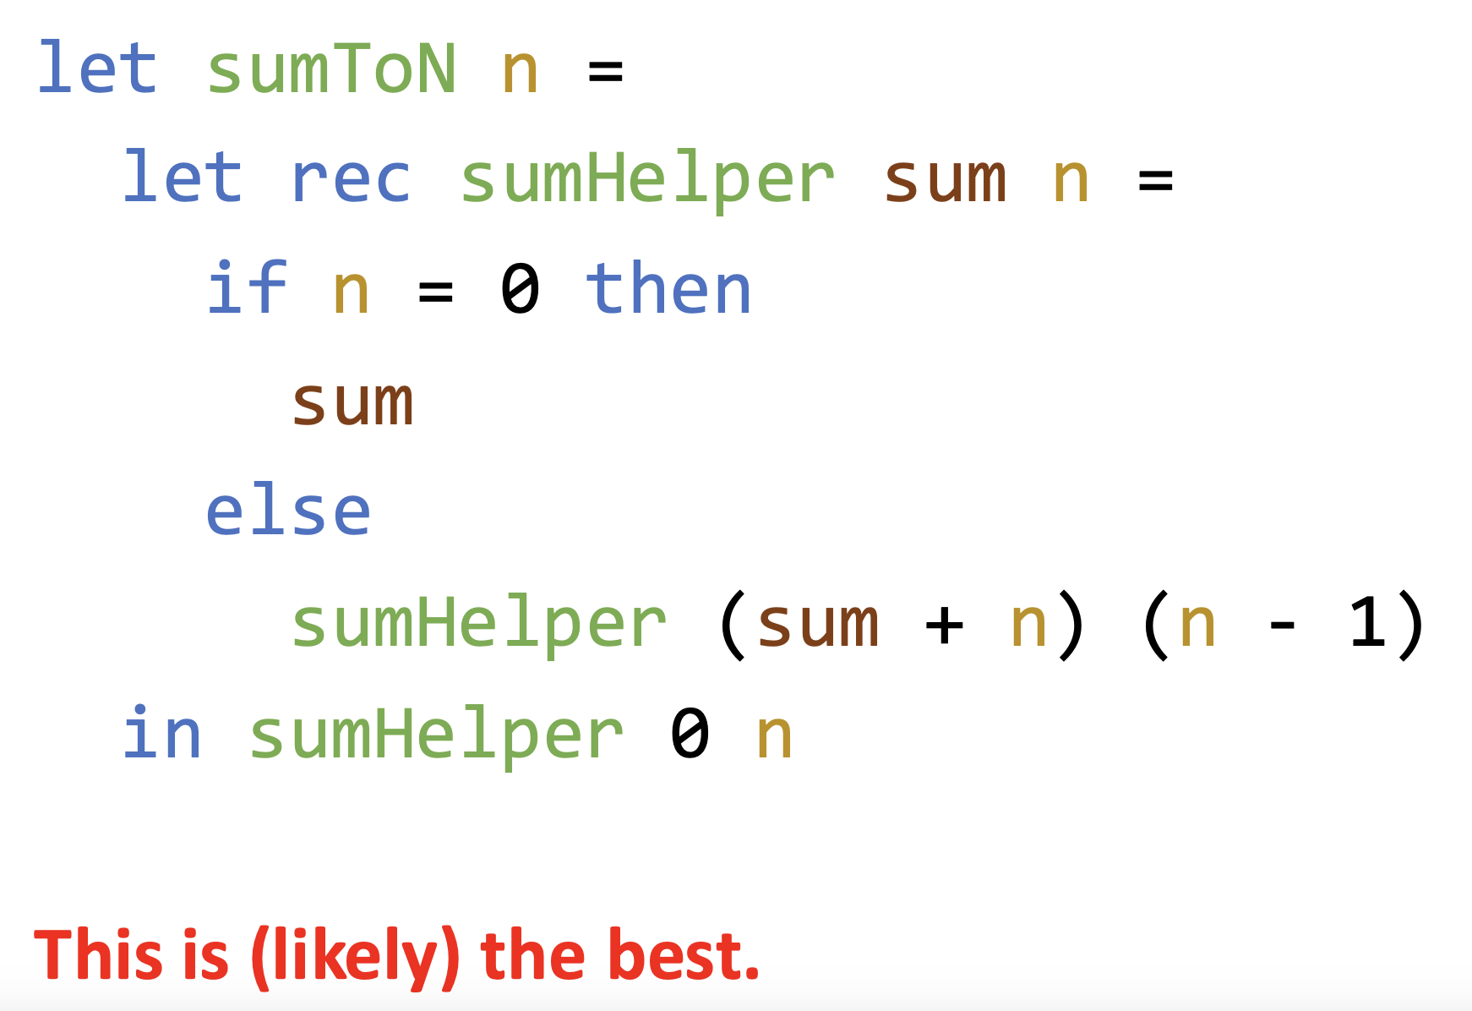
Solution 3: Renamed Local Binding

Slide 11
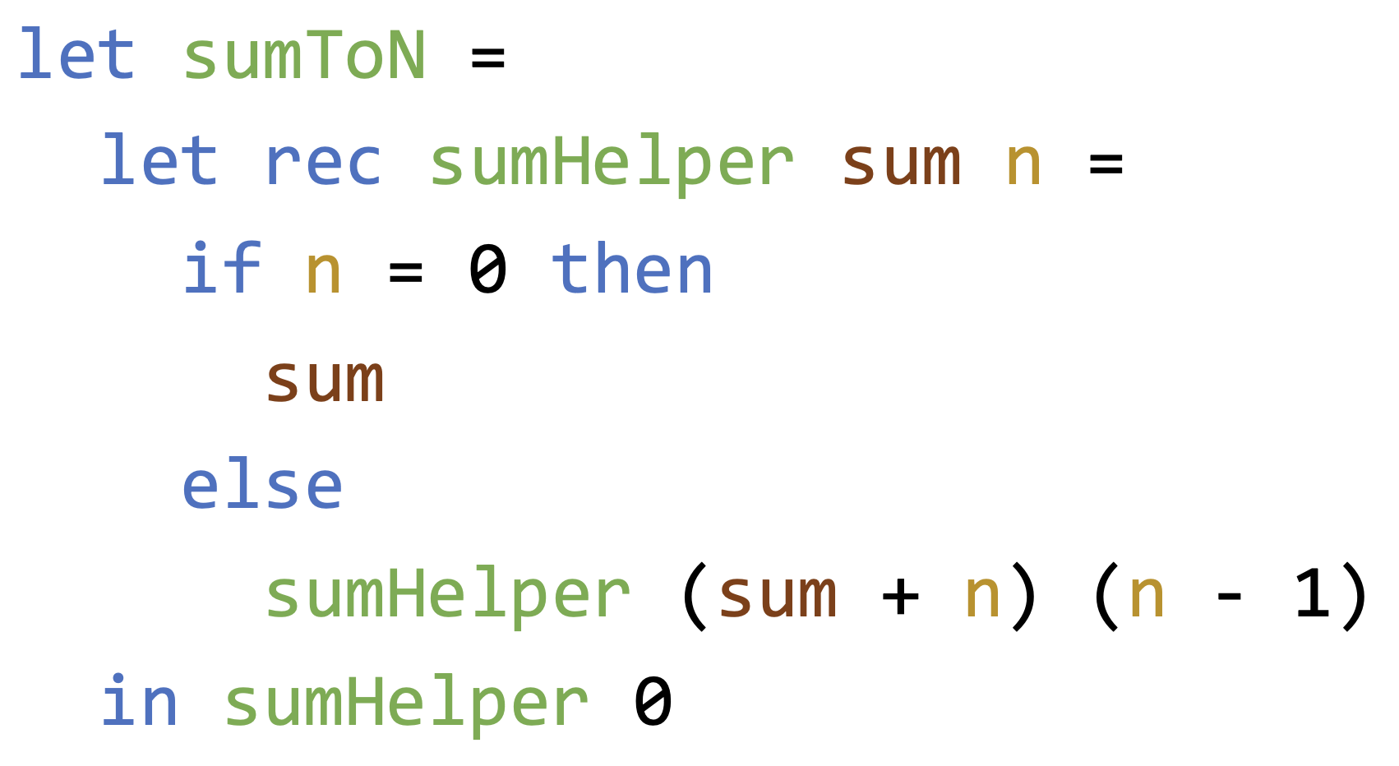
Bonus: Removing Arguments
This also works. Why?

Slide 12
Why Even Do Tail Recursion
It is a while loop. We get our loops back.
Deep non-tail recursion can overflow the call stack
Many functional programming languages such as OCaml guarantee tail-call optimization (TCO)
Many imperative/OOP languages such as Java lack guaranteed TCO
While some C++ compilers may apply TCO in certain cases, the language does not require or guarantee it

Slide 13
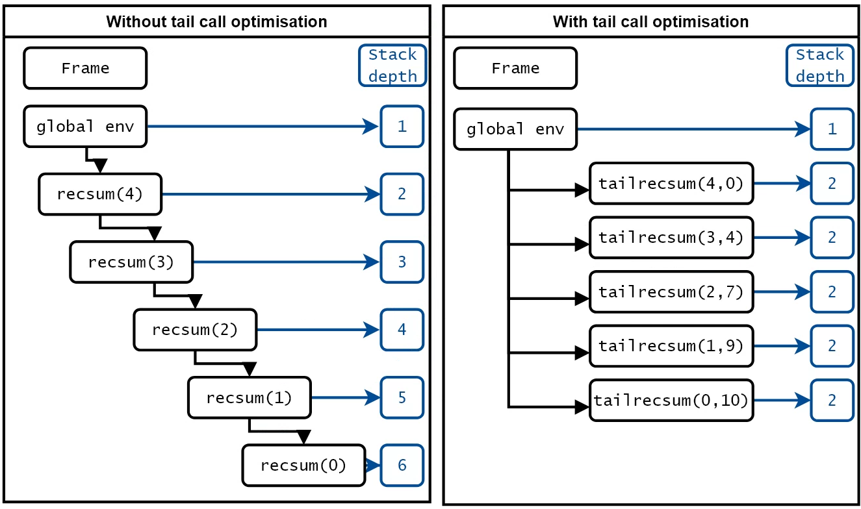
Call Stack Safety

Slide 14
Keys of Tail Recursion
The result is already in the parameter, so recursion is tail-recursive
The parameter is called an accumulator
Tail recursion typically has only ONE recursive call per step
Walk forward step by step and carry enough info to return immediately
The carried info is saved in accumulator(s)

Slide 15
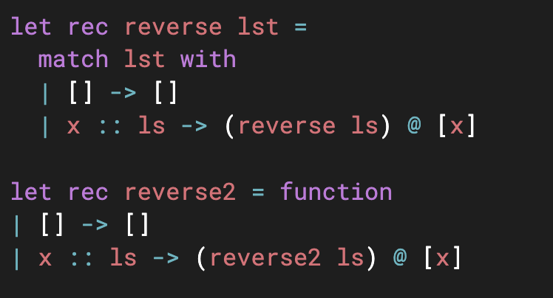
Another Problem: Reverse a List
Recall the example we did:
Operator @ takes O(n) where n is the length of the left list
What is the total running time of reverse?

Slide 16
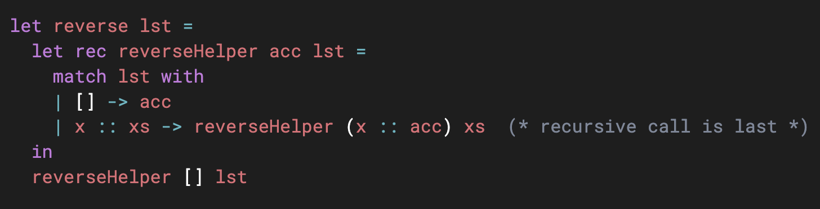
Reverse a List: Tail Recursion
Can you rewrite it in tail recursion?
What is the running time of this tail recursive version?

Slide 17
Exercise
Factorial of n (Tail Recursive with local helper)
Fibonacci n-th number (Tail Recursive with local helper)
Notes:
let factorial n =
let rec helper n acc =
if n = 0 then acc
else helper (n - 1) (n * acc)
in
helper n 1
let fib n =
let rec helper n a b =
if n = 0 then a
else helper (n-1) b (a+b)
in
helper n 0 1
For fib: (n) to (n-1) is to track the number of steps needed. We actually compute fib n from bottom up 0 1 1 2 3 5 8 13 … So starting from 0 1, then 1 1, then 1 2, then 2 3, we use a b to carry two numbers at each step. After n steps, return the result (i.e., a)

